Slide 1
Introduction to Data Mining CS07480-1 Fall 2019
Project Description

Slide 2
Project Goals
In this project, you will have an opportunity to apply the data mining algorithms and techniques you learned in the class to some real-world problems.
You can choose any problem that you are interested in, and formalize it into a data mining task.
You get some data related to the task and apply some data mining algorithms to your data. Also you need to evaluate and compare your algorithms.
Finally, you should submit a report, together with your data and code.

Slide 3
Project Stages
The project is a mandatory part of this course.
Students are at liberty to form teams.
Each team can have up to 5 students at the maximum.

Slide 4
Deadlines
1-2 pages of project proposal (abstract): Oct 11th (11:59pm) 5%
What do you want to solve? (with brief description of dataset)
Why do you think it is important?
What results do you expect?

Slide 5
Milestone # 1 : Nov. 4th (11:59pm). 5%
Report draft .
Discuss about progress.
Issues and difficulties you have met

Slide 6
A final report, data, and code : 1 week before the final presentation.
At least two algorithms and two evaluation methods.
4 pages minimum.
Please follow IEEE paper guidelines for the format (https://www.ieee.org/conferences_events/conferences/publishing/templates.html )

Slide 7
Additional features (5% extra)
Novelty of the problem
Your own data
More than two algorithms/evaluation methods
Other innovative features (e.g., new algorithm)

Slide 8
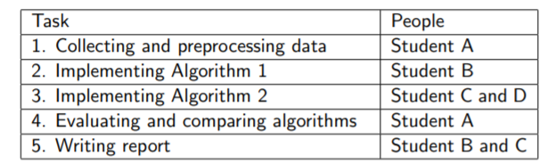
Collaboration Rules
Every member in a team gets the same score .
Exception: the team has the right to claim someone as a free rider, and we will lower his/her score .
A table describing your division ,for example:

Slide 9
Datasets
UCI Machine Learning Repository
http://archive.ics.uci.edu/ml/

Slide 10
Sample Projects
Students’ previous machine learning projects in Stanford University: http://cs229.stanford.edu/projects2011.html
Problem
Determine whether a given email is spam or not
Data Mining Task
Binary classification
Data
UCI spam data set (http://archive.ics.uci.edu/ml/datasets/Spambase )
Number of instances: 4601
Number of attributes: 57
The last column denotes whether the e-mail was spam (1) or not (0)
Partition it into training set and test set

Slide 11
Algorithms
Naive Bayesian classifier
Artificial neural network
AdaBoost
Evaluation and Comparison
Error rate
ROC and AUC
Speed

